Slide 1
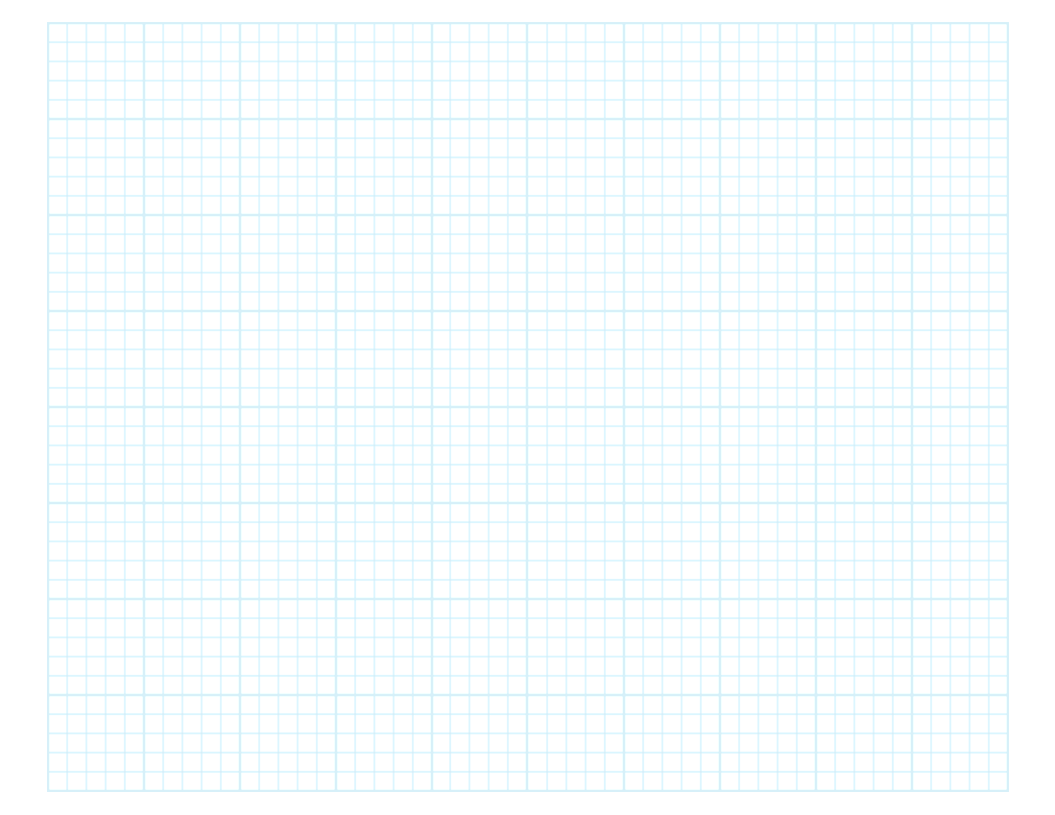

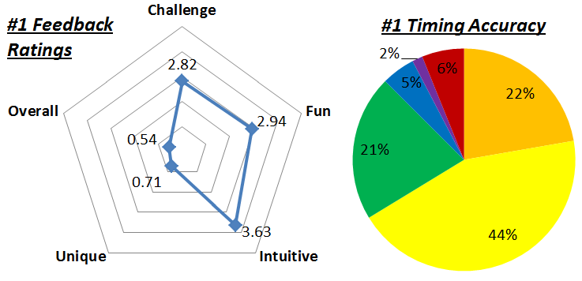
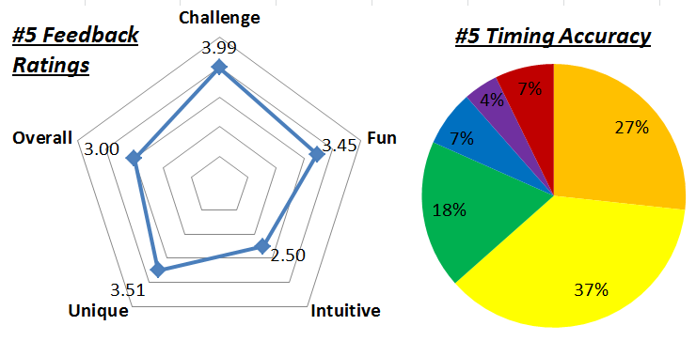
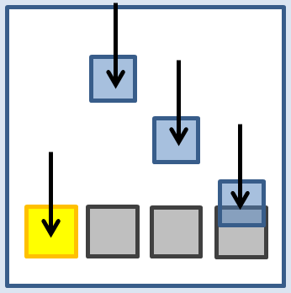
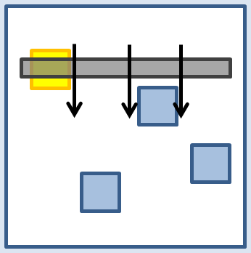
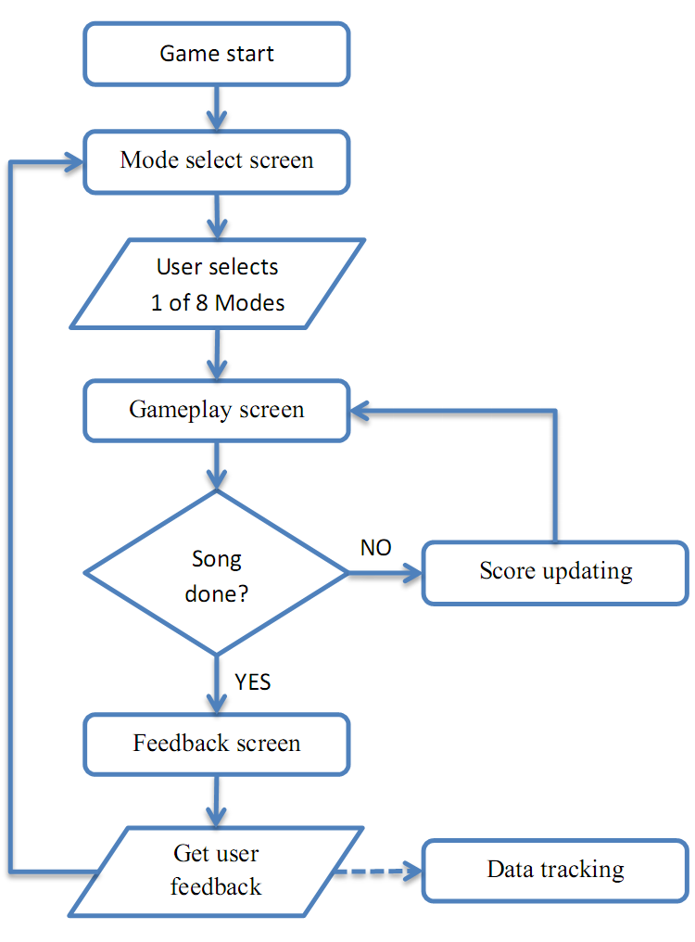
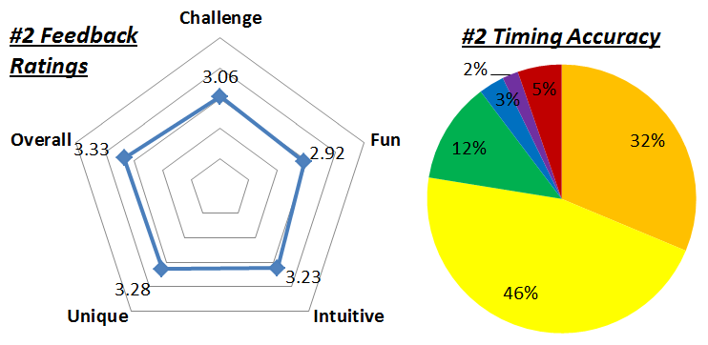
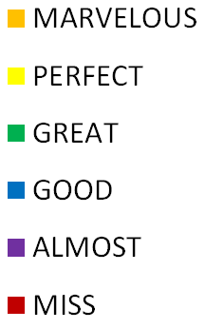
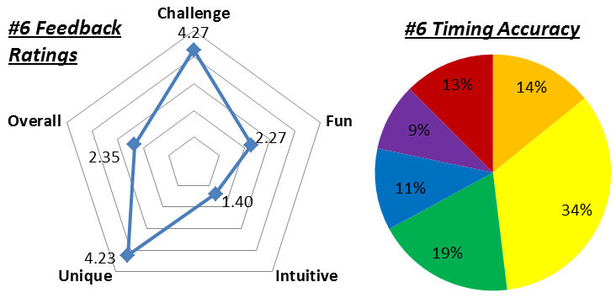
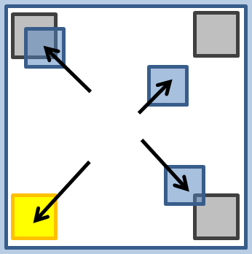
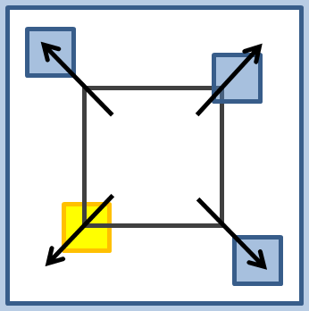
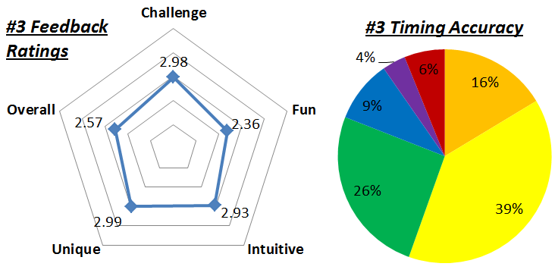
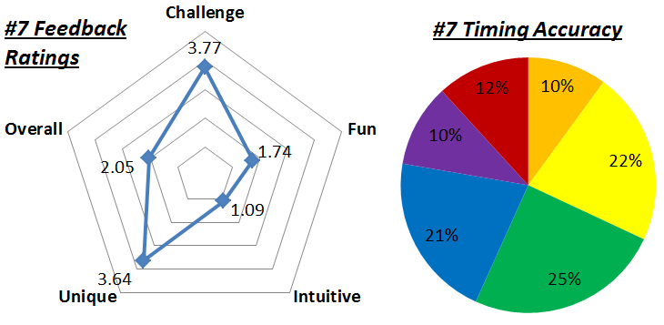

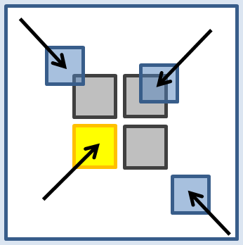
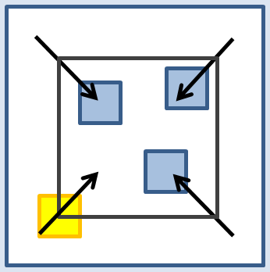
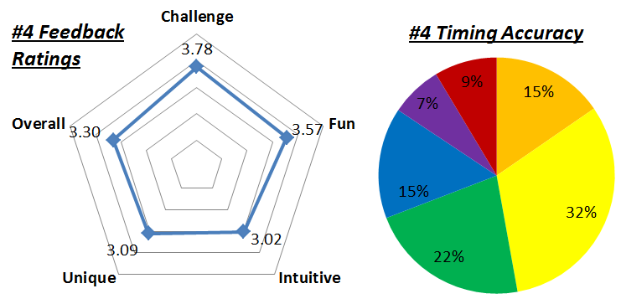
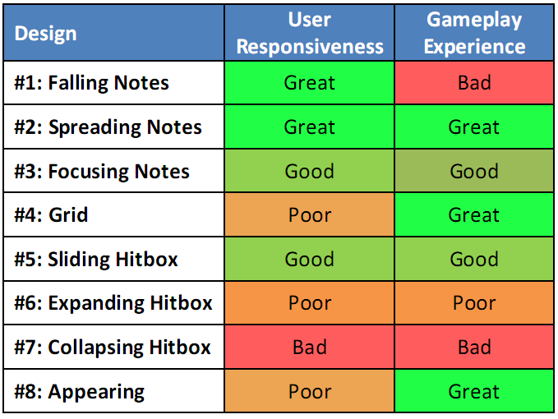
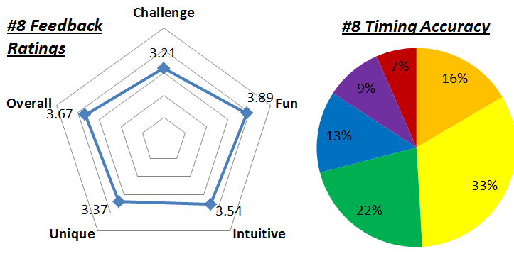
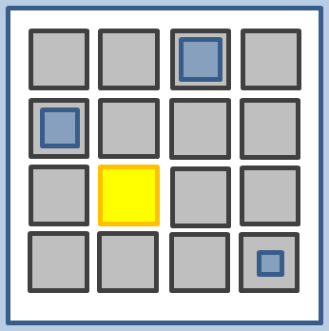
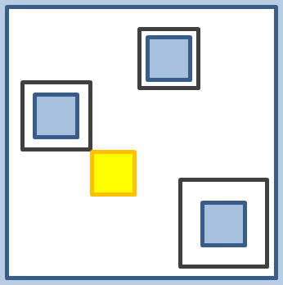
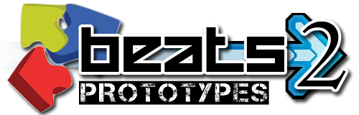

Designing Rhythm Game Interfaces for Touchscreen Devices
Philip Peng, Faculty Advisor: Stephen H. Lane
Design 1: Fall
http://beatsportable.com
Design 5: Slide
Abstract:
This project focuses on comparing different user interface designs for rhythm games on touchscreen devices. This is accomplished through the development of prototype rhythm games and analyzing collecting gameplay data.
Implementation:
“Beats2 Prototypes”, a rhythm game designed for Android tablets, was published on Google Play. This poster presents the eight interface designs prototyped in the app and their respective data collection summaries.
Moving notes fall toward fixed hitboxes from top to bottom
Rhythm Games: Dance Dance Revolution, Guitar Hero, Beatmania IIDX
Moving hitbox fall toward fixed notes appearing from top to bottom
Rhythm Games: DJMax Technika
Timing Accuracy:
During gameplay, note hits are assigned timing accuracy values based on the difference between expected and actual note hit times. The distribution of these values reflect on how the user interface affects the user responsiveness.
A high percent of “MARVELOUS” and “PERFECT” values means that the interface allows for accurate visual recognition (of note/tapbox elements) and high user reactivity (note tapping action).
Timing Accuracy
Design 2: Spread
Design 6: Expand
Moving notes slide toward fixed hitboxes from centre to corners
Rhythm Games: none
Expanding hitbox grows toward fixed notes from centre to corners
Rhythm Games: none
Design 3: Focus
Design 7: Collapse
Feedback Ratings:
At the end of a song, the user is prompt to give qualitative feedback ratings on a 1-5 star scale. These star ratings reflect on various aspects of the gameplay experience.
Challenge: Difficulty of gameplay. More difficult = higher skill ceiling.
Intuitive: Usage learning curve. More intuitive = higher reactivity.
Fun: Game enjoyability. More fun = more returning users.
Unique: Novelty of design. More unique = more first time users.
Overall: General evaluation of gameplay experience.
Moving notes slide toward fixed hitboxes from corners to centre
Rhythm Games: Gitaroo Man Lives!, Hatsune Miku: Project DIVA
Collapsing hitbox shrink toward fixed notes from corners to centre
Rhythm Games: none
Design 4: Grid
Conclusion:
Based on these results, each interface design was ranked relative to each other. Of the eight designs studied, Design #2 is the best candidate for usage in future rhythm game development.
These results can also be applied in the design of user interfaces for other
Design 8: Appears
Expanding notes grow in fixed hitboxes at grid points
Rhythm Games: jubeats
Collapsing hitboxes shrink around fixed notes appearing at grid points
Rhythm Games: Osu! Tatakae! Ouendan!
future applications on touchscreen devices. As touchscreen technology become more and more commonplace, user interfaces for interacting with touchscreen elements in time-critical scenarios (such as military or medical applications) will benefit from designs improving user responsiveness.

